Slide 1
Jupiter Medical Center
Volunteer Awards Ceremony
April 2026

Slide 2

5,000 VOLUNTEER HOURS

Slide 3
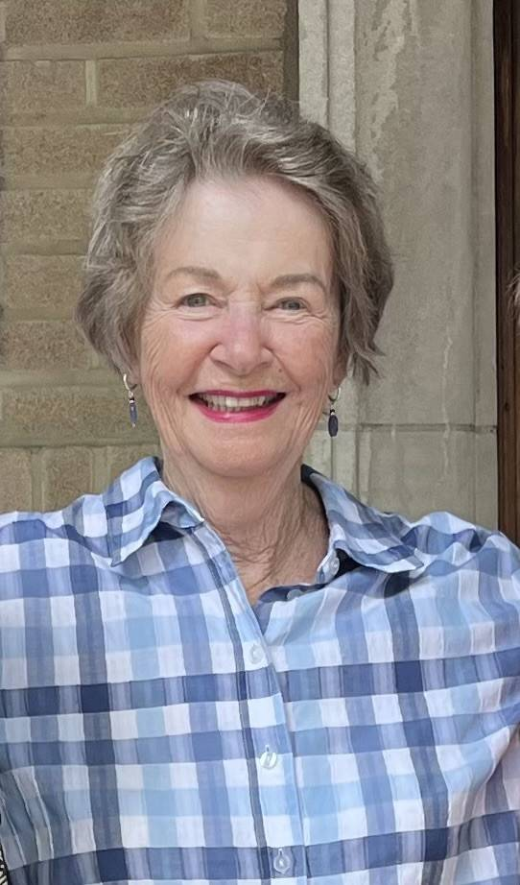
Marcella Baker
Greeter and Nursing Floor
“I started volunteering after a stay at JMC as a patient. I was impressed and thought maybe I’d see about helping a little bit. Well, the volunteer bug bit me. I volunteer twice a week; one day visiting patients on the Oncology Unit and one day as a Greeter. I find that when I help someone else, it makes me feel better than it makes them feel. And I’ve met many salt-of-the earth folks over the years that I’ve volunteered with. I go home smiling every time.”

Slide 4
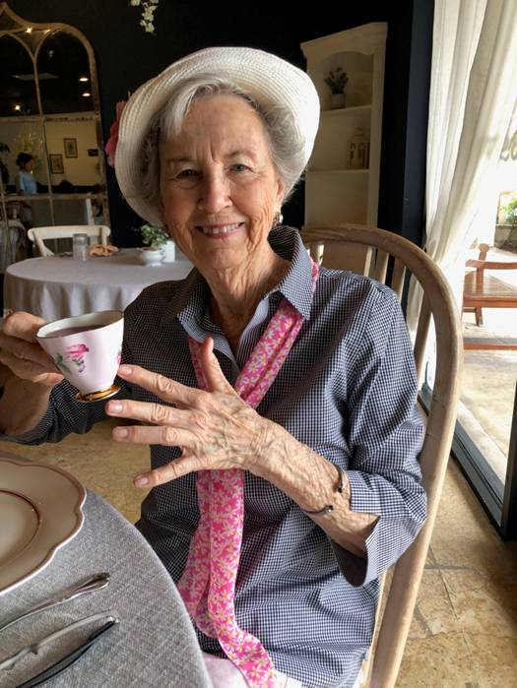
JoANN Oswald
Thrift Shop
“After years of playing team tennis and then watching grandchildren, I was at a loss. Tennis was a great way to make new friends and my grandchildren gave me joy.
Soon, I found the Jupiter Medical Center Thrift Shop. There, I found friends and joy in helping. It was the perfect answer. Volunteering gives me pleasure, activity and most importantly, friends.
I always look forward to my days volunteering at the Thrift Shop. Thank you for letting me be a part of the hospital community.”

Slide 5
10 Years of Service

Slide 6
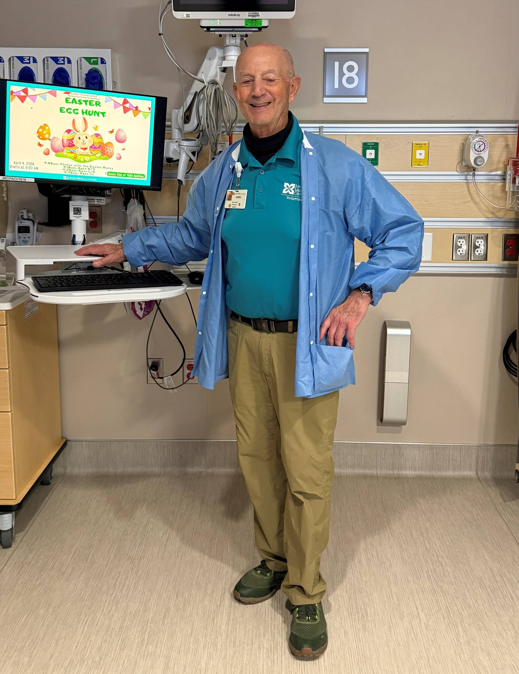
Gerry Berlin
PACU
"I feel truly blessed and fortunate to have had a years' long career in not only the practice of Anesthesiology, but also an equally long career in educating future anesthesiologists. Volunteering is a small way to give something back to my community. This experience has also given me the opportunity to work with the very capable and caring PACU nursing staff at Jupiter Medical Center. At my very first Volunteer Luncheon I remember hearing a guest speaker tell us those that can, do. . . . . those that can do more, volunteer. "

Slide 7
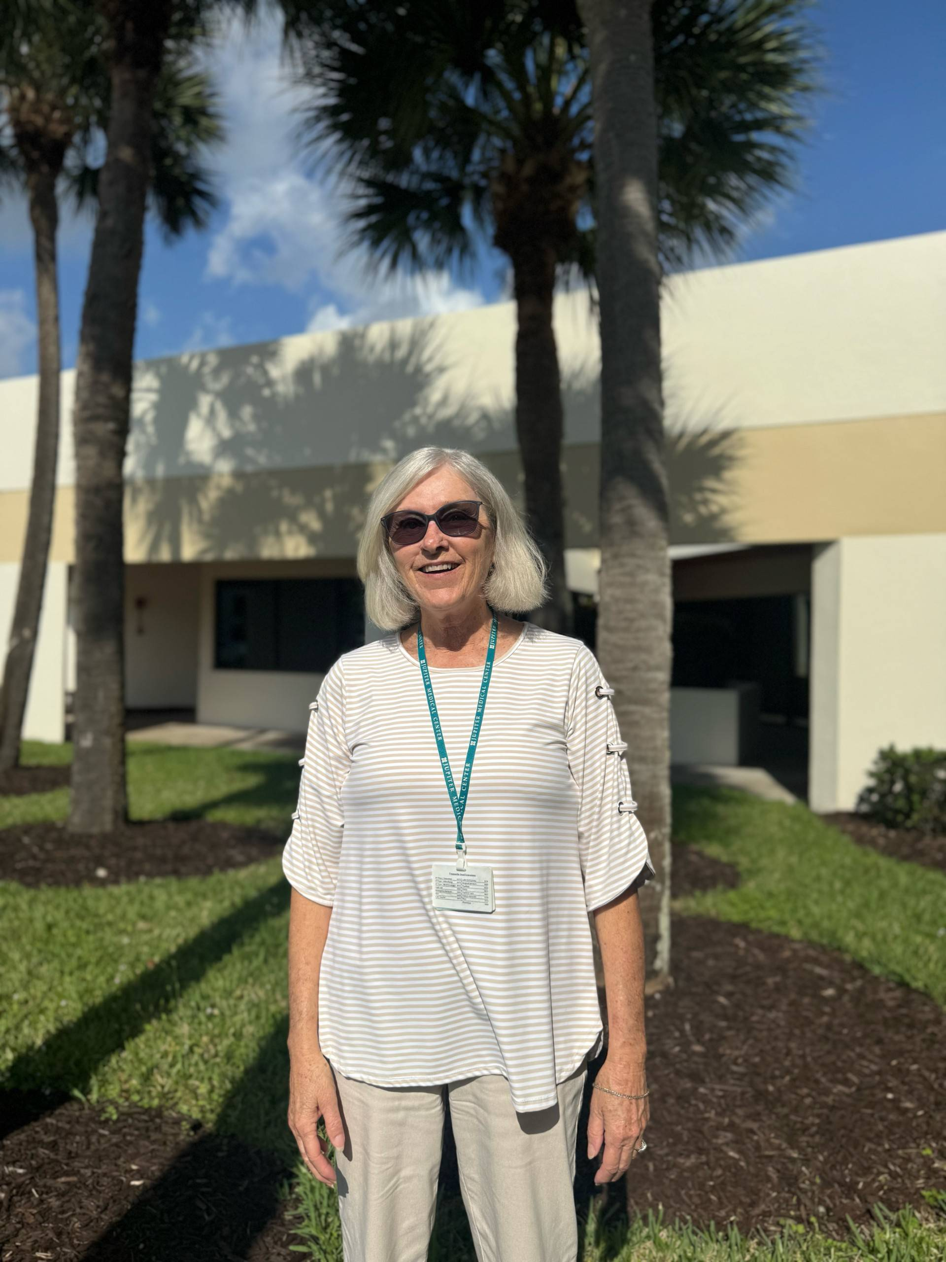
Annette Hearl-Thomas
Chemotherapy and Infusion Center
I became a JMC volunteer by accident…literally. When my husband witnessed a fender-bender and offered his assistance, he met a Motor Aid volunteer who encouraged him to join their team. He then suggested that I contact the Auxiliary Office. When given the choices of volunteer opportunities, I said, “Anything but a desk job.” I enjoyed assisting the Activities Director at the Skilled Nursing & Rehabilitation Center. When the facility closed, I began volunteering at the Anderson Family Cancer Institute. The nurses and the patients and their loved ones are grateful for our assistance. It is rewarding to know that I am making a positive difference in the life of others, to see them smile (or even laugh) and to be a good listener.
Dominique complied with my request for anything but a desk job and has kept me on my feet for the last ten years.

Slide 8
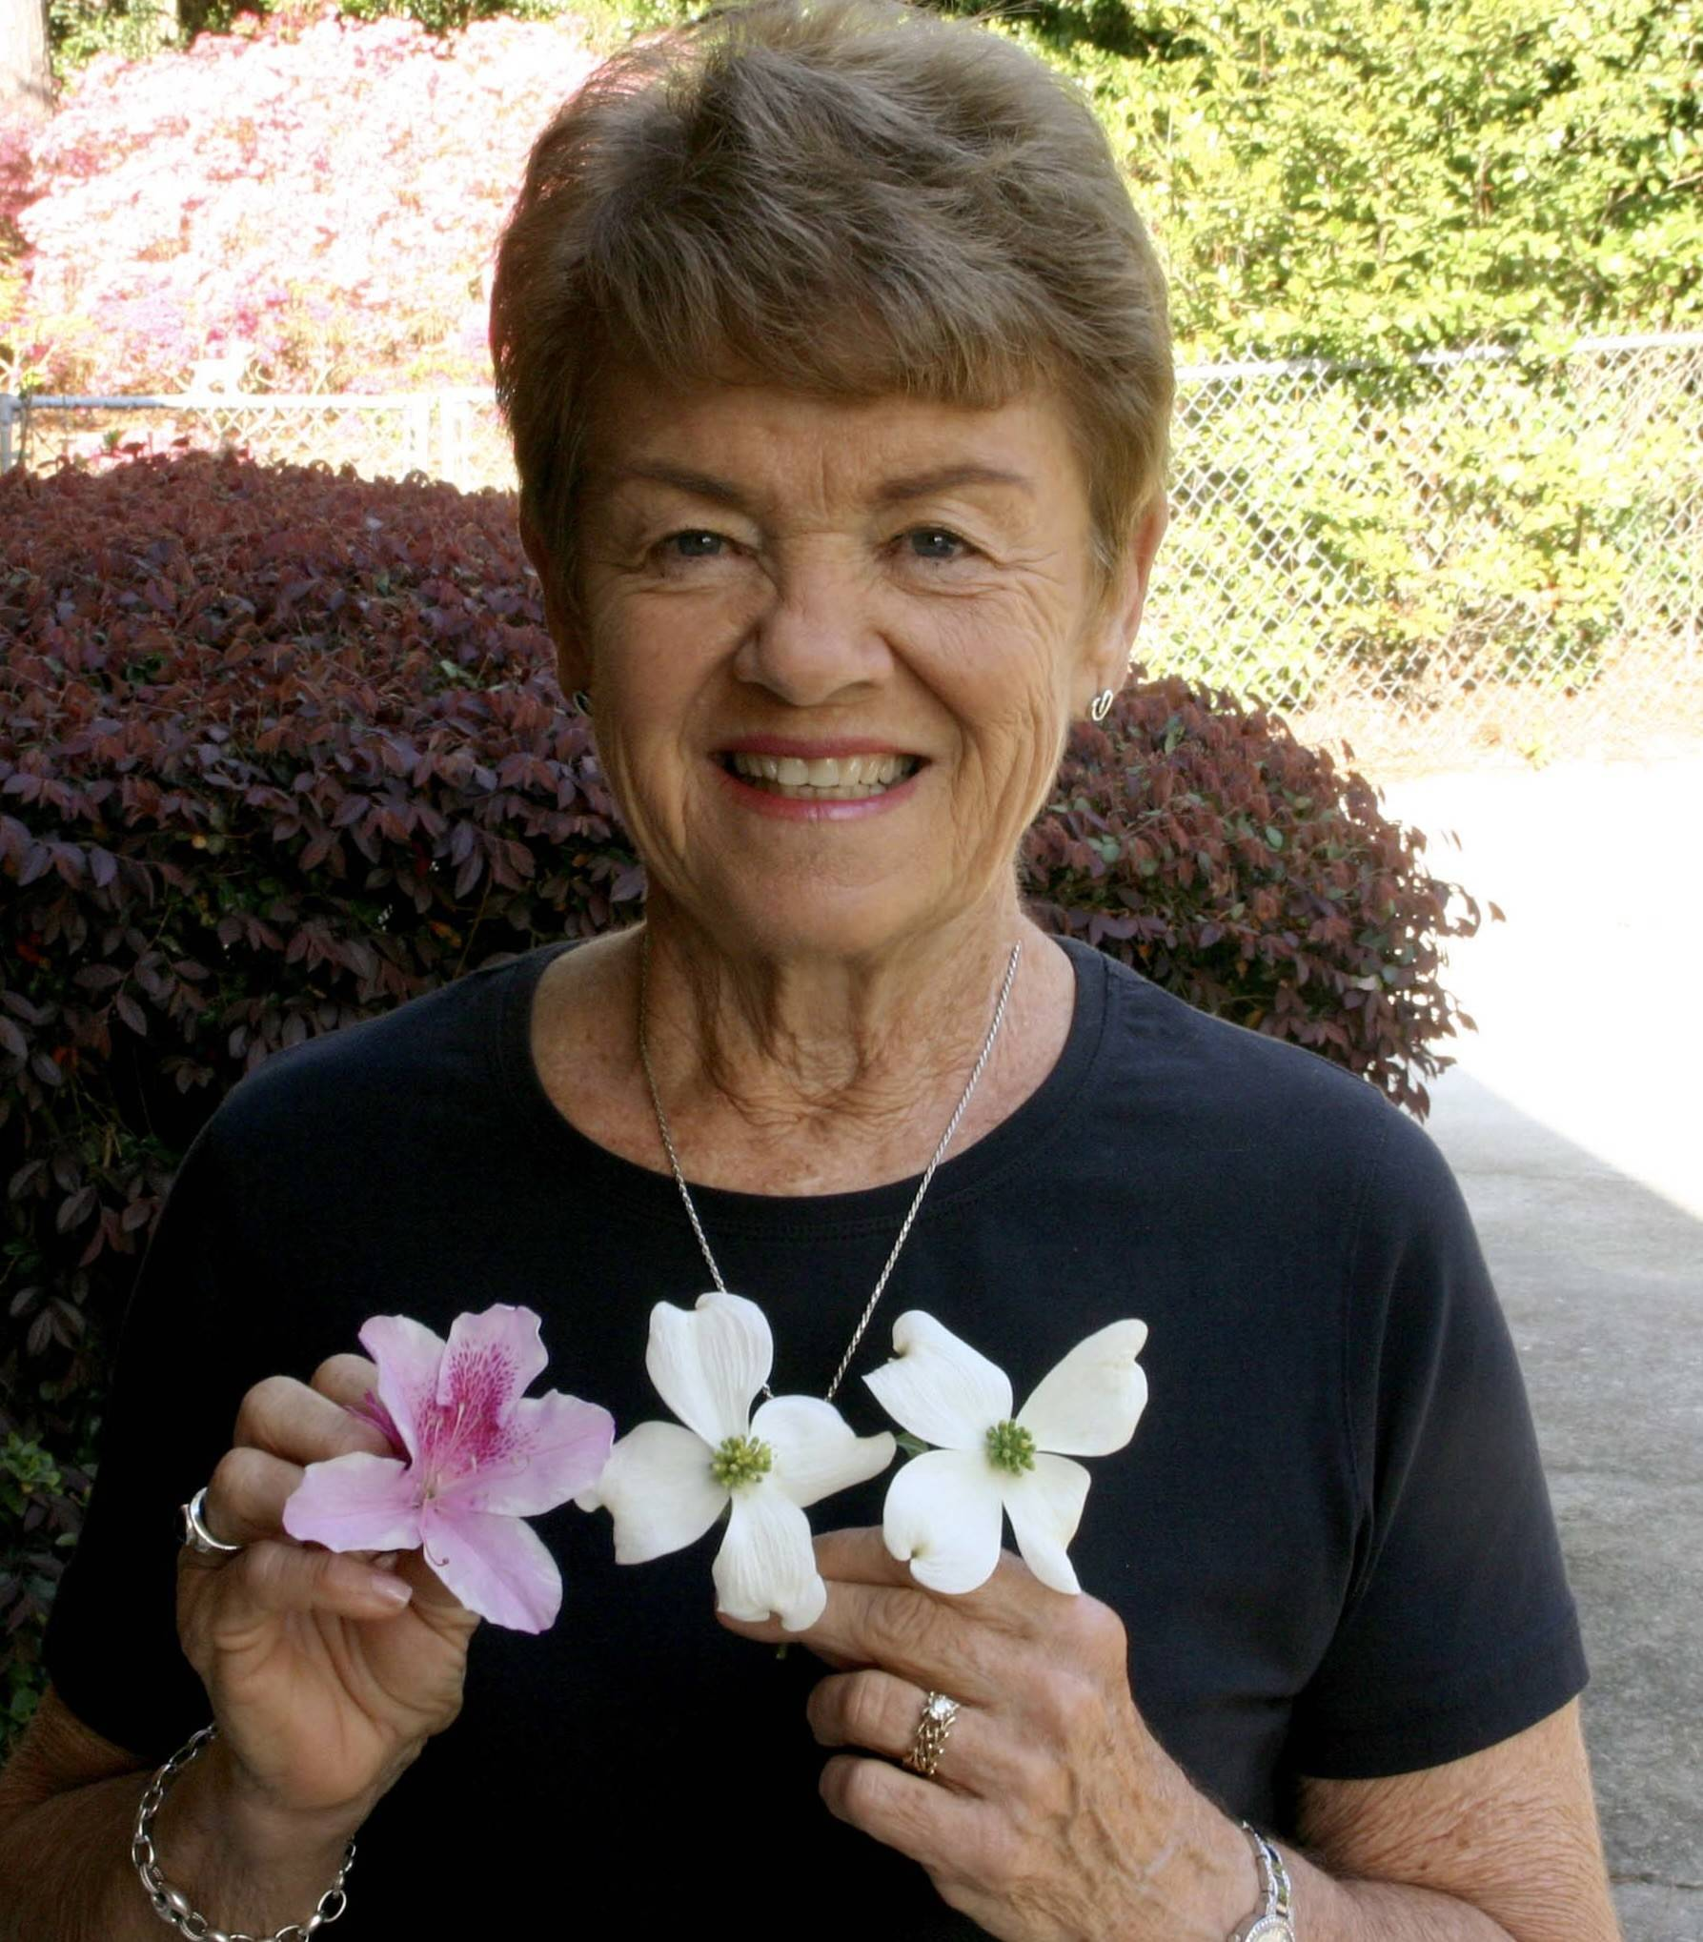
Barbara Hill
GI Waiting Area
“Inspired by the exceptional care my husband received during orthopedic surgery at Jupiter Medical Center, I became a volunteer to give back. I began with outpatient phlebotomy and now serve in the GI waiting area, supporting patients before procedures and assisting lab staff. It is my pleasure to serve.”

Slide 9
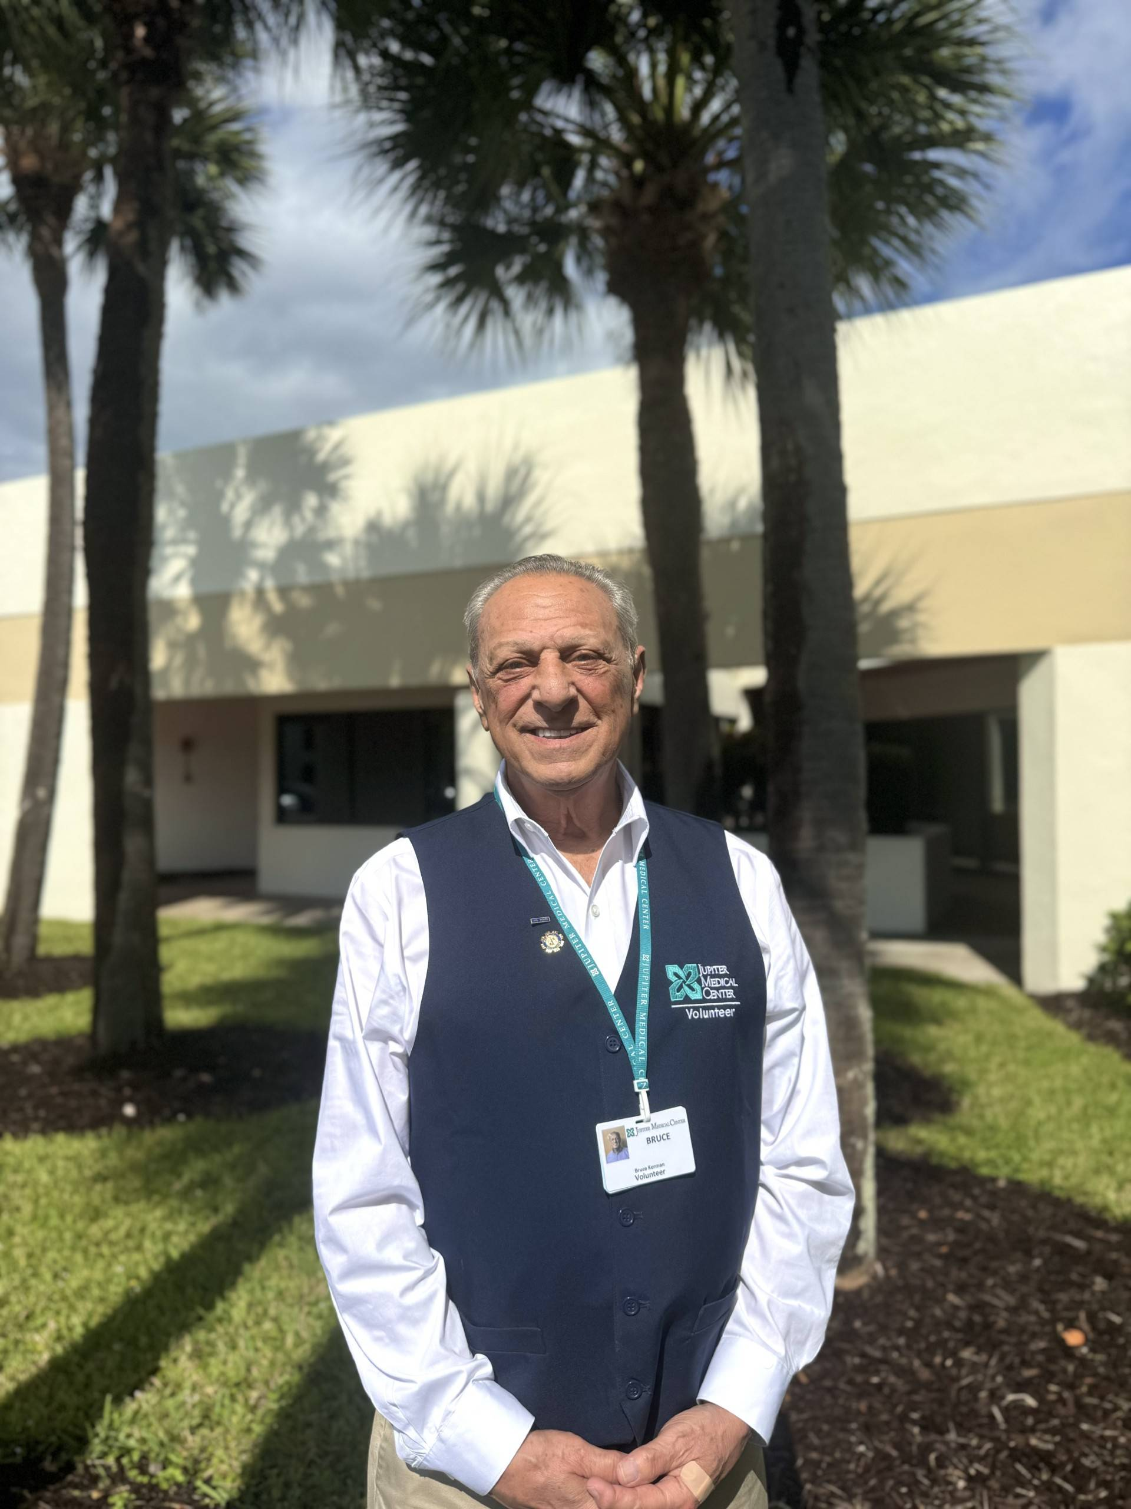
Bruce Kerman
Greeter
“The experience is incredibly rewarding, providing a source of purpose and the opportunity to build meaningful connections with both staff and fellow volunteers. Ultimately, I am proud to contribute to the mission of an independent, top tier medical facility. Knowing that my time helps enhance the overall experience for everyone we serve.”

Slide 10
Mary LEgan
Thrift Shop
“After retirement, I needed an outlet to keep me involved. My husband went to JMC for many treatments, surgery, etc. over the years. The care he got at JMC was exceptional. I wanted to give back and needed an active assignment. I interviewed for the Thrift Shop. I became a part of the team there.
Over the years I’ve worked with a lot of good men and women at the Thrift Shop. We work together to make our little store profitable.
I am a proud and grateful Volunteer representing Jupiter Medical Center.”

Slide 11
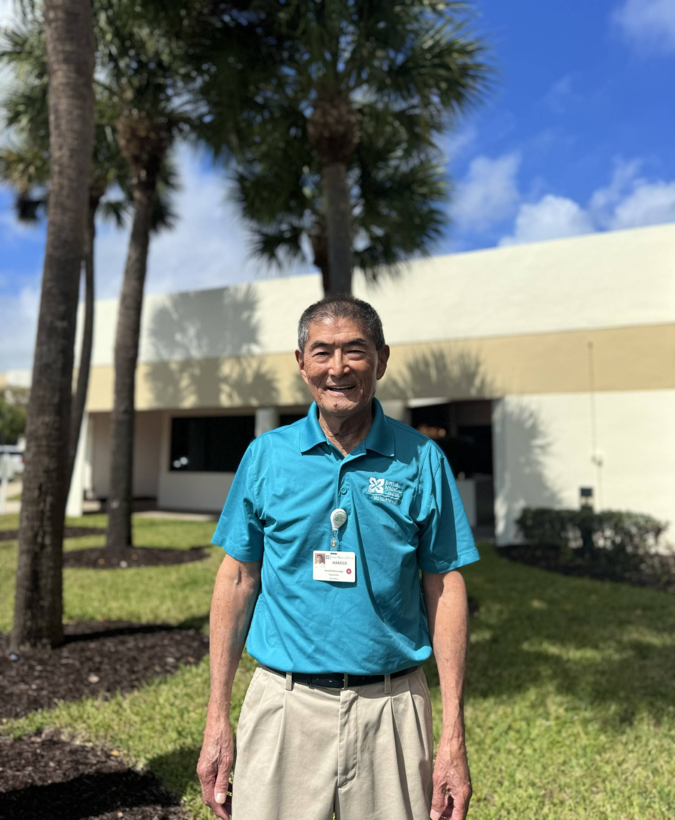
Harold Matsunaga
Special Projects
“I decided to volunteer to discover opportunities after retirement and a way to payback some of the good will and support I received along the way.
Being a volunteer helps to understand the work of an organization and gives you an insider's view that one would not have otherwise. There is the satisfaction of doing something to help meet the daily work requirement.
The volunteers are a wonderful group to work with, always willing to help no matter the task.”

Slide 12
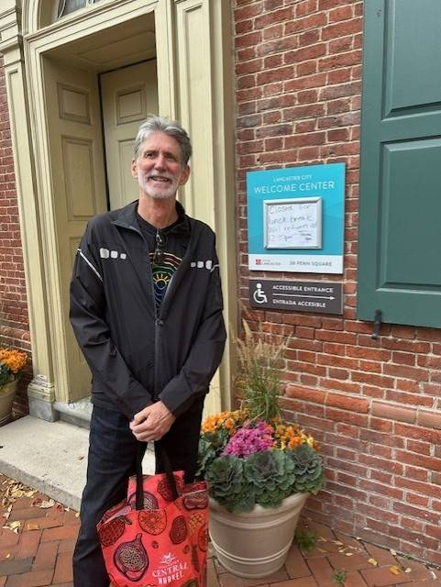
Bob Mcgaw
Greeter
“Following my retirement in 2012, my wife & I relocated to Jupiter. In an effort to give back to our new community, I became interested in becoming a JMC volunteer. My wife, the designated family shopper, was already working (and spending my pension) at the JMC Gift Shop. Motor Aid was looking for additional drivers, I had a drivers license & was eager to assist transporting patients to the hospital for appointments. After the Covid pandemic, I joined the Volunteer Greeter Team, affectionately known as the “A” Team. This position became a perfect fit for me as you can find me at the Front Entrance every Tuesday morning.”

Slide 13
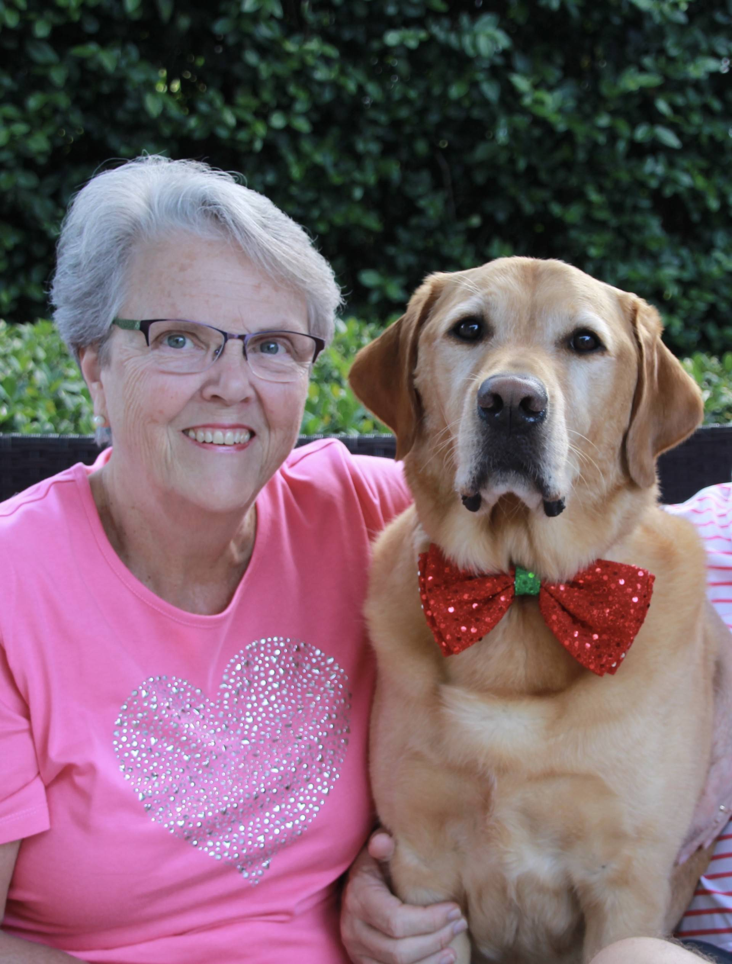
Pam Reynolds
Human Resources
“I knew when I retired that I wanted to volunteer somewhere in some capacity. Having JMC right in my neighborhood made my decision easy!
When I began volunteering, I was scheduled for two days each week in the Cancer Center. However, Dominique called and asked me if I could help the Human Resources department - only for a couple of weeks - catch up on their filing - thus one day in HR and one day at the Cancer Center. Well… ten years later I am still in HR trying to keep them caught up!!
The HR team members are like my second family - I cannot wait to see them every Thursday! They are all so appreciative of any assistance. Each time I leave at the end of my shift, I hope that I have lessened their workload to some extent!”

Slide 14
15 Years of Service

Slide 15
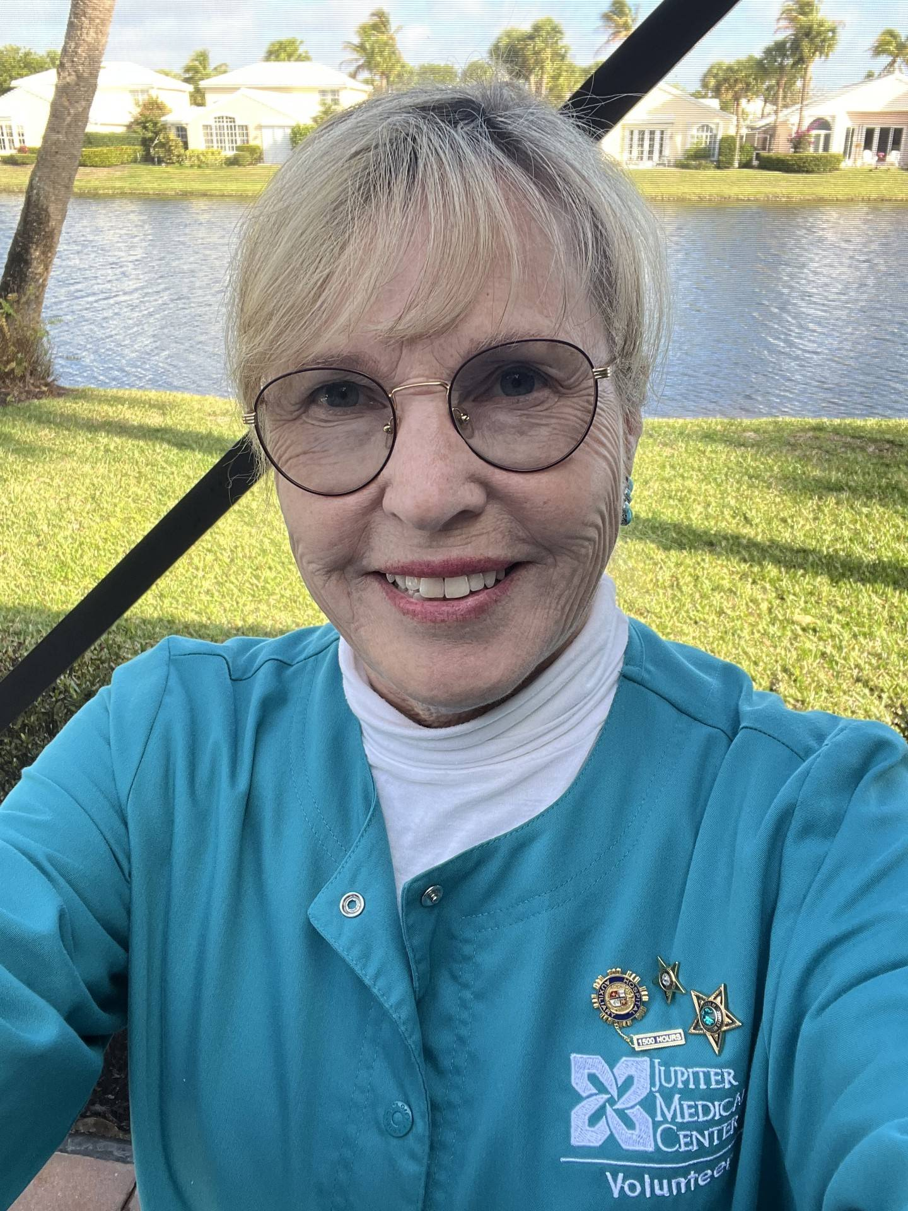
Belinda EICHLER
Chemotherapy and Infusion Center
“When my husband died 16 years ago, I was devastated. What would I do with myself? I had always worked in hospitals and health agencies, so I thought about volunteering in that setting. A bereavement counselor however advised me to do something totally different…join the Lighthouse and become an artist. I weighed my options and couldn’t help myself. I called Dominique and joined the JMC Auxiliary. That was 15 years and at least six types of volunteer assignments ago.
I am still not an artist, but I love my current assignment working in the Chemotherapy & Infusion Center at the Anderson Family Cancer Institute!”

Slide 16
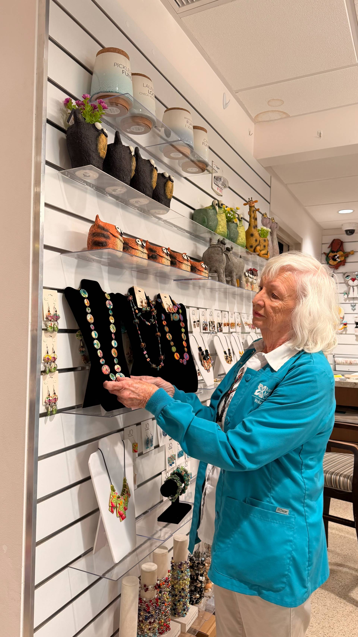
Martina Elmore
Gift Shop
“I have always volunteered. Since I managed the Gift Shop at the Norton Museum of Art in West Palm Beach when I was younger, I was always interested in volunteering in a Gift Shop. I used to volunteer at Martin Memorial Hospital’s Gift Shop. When I decided to volunteer at Jupiter Medical Center, I was happy to volunteer in the Gift Shop.”

Slide 17
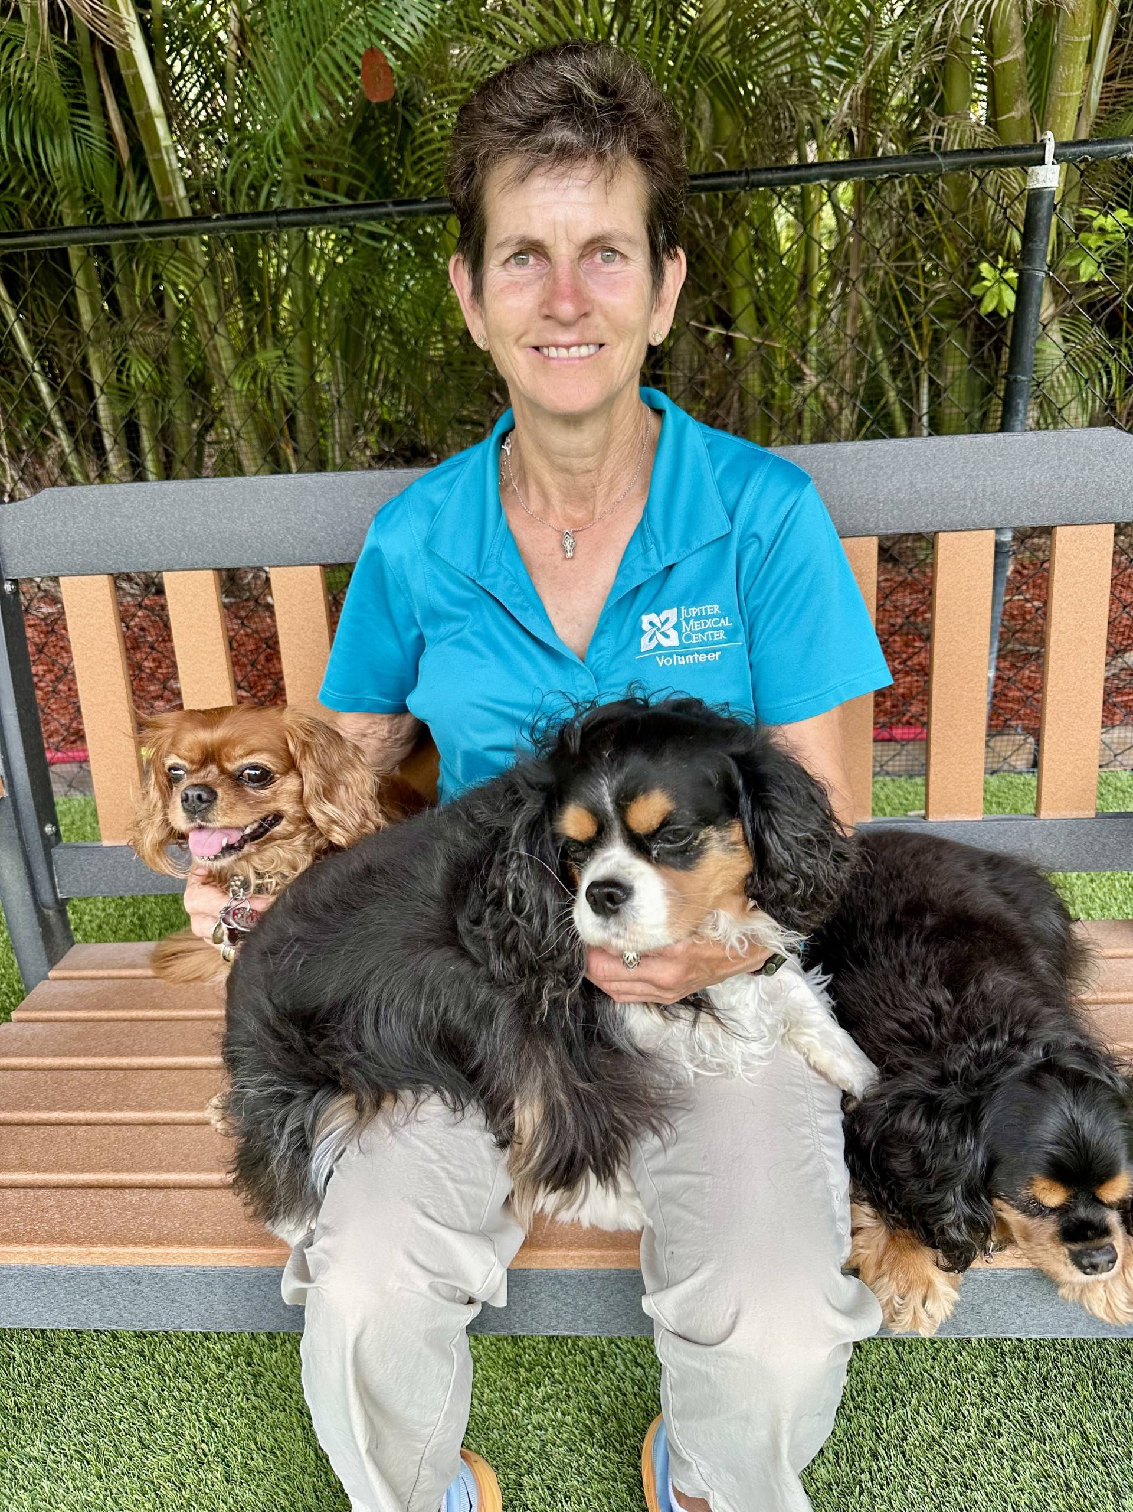
SUSAN GOLDSMITH
Pet Therapy
"I began volunteering as I wanted to be able to give back to the community in a way that was meaningful to me and that was with my dogs. Whether it is seeing a patient smile or a team member saying “you’ve made my day” reminds me of the joy and comfort that therapy dogs can bring to everyone."

Slide 18
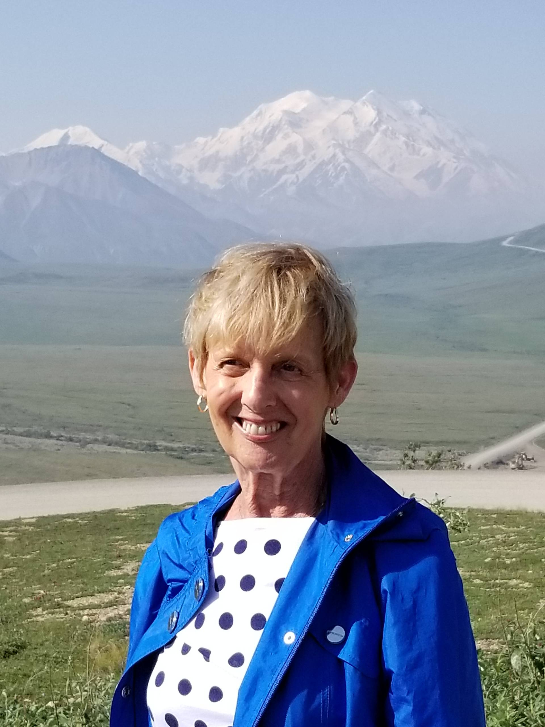
Norah grubmeyer
Margaret W. Niedland Breast Center
"When I retired 15 years ago, I was thinking about doing volunteer work. I had an appointment for a mammogram at the Margaret W. Niedland Breast Center and when I was there, I asked them if they needed any volunteers. The receptionist said they did and she directed me to the Auxiliary Office where I filled out an application and went to a Volunteer Orientation the next day.
Over the years my duties included taking patients to the changing area and sending out appointment reminder letters and result letters to patients.
I enjoy working with the team members at the Breast Center. They are all friendly and very nice."

Slide 19
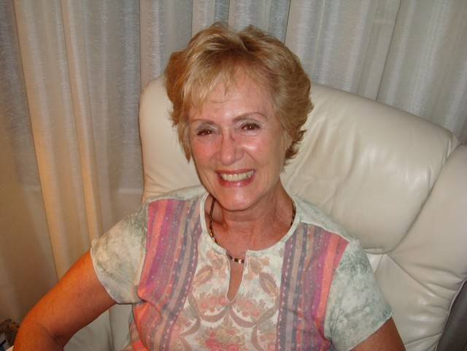
Dee PEREZ
Thrift Shop and Past President
“After retirement from a fulfilling municipal career in NJ, I chose to stay active and continue contributing to something meaningful. These fifteen years have brought purpose, friendships, and a deep appreciation for the dedicated individuals who make Jupiter Medical Center exceptional. It has truly been an honor to serve!”

Slide 20
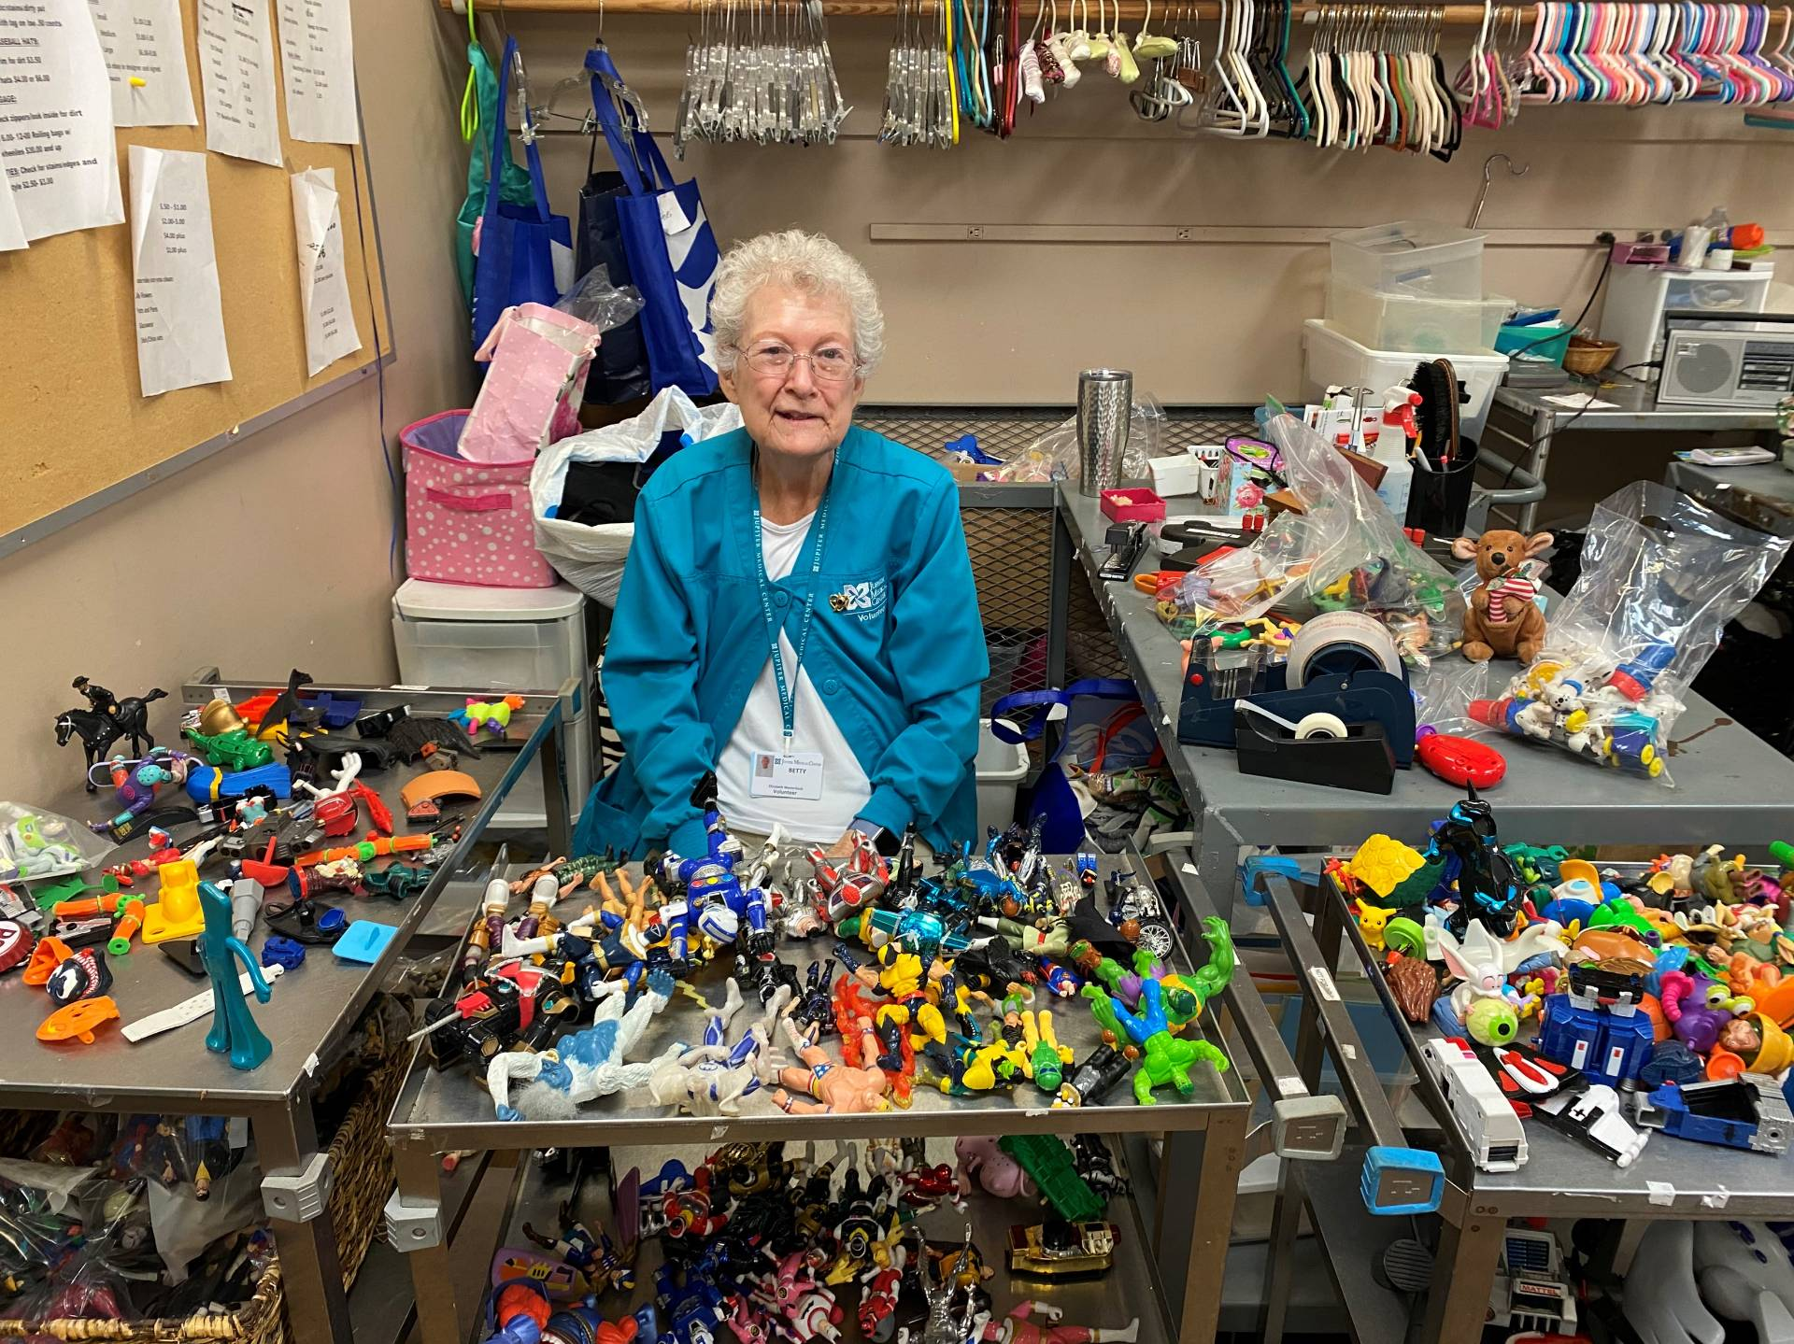
Betty Westerbeck
Thrift Shop
“Fifteen years have flown by. When I started volunteering at the Thrift Shop I trained at different work-stations: Clothing, Linens, Housewares and Toys. I decided to help out in the Toys; I sort, clean, price and display items in the toy section. Watching young ones finding that special toy gives me great satisfaction. I love my job!”

Slide 21
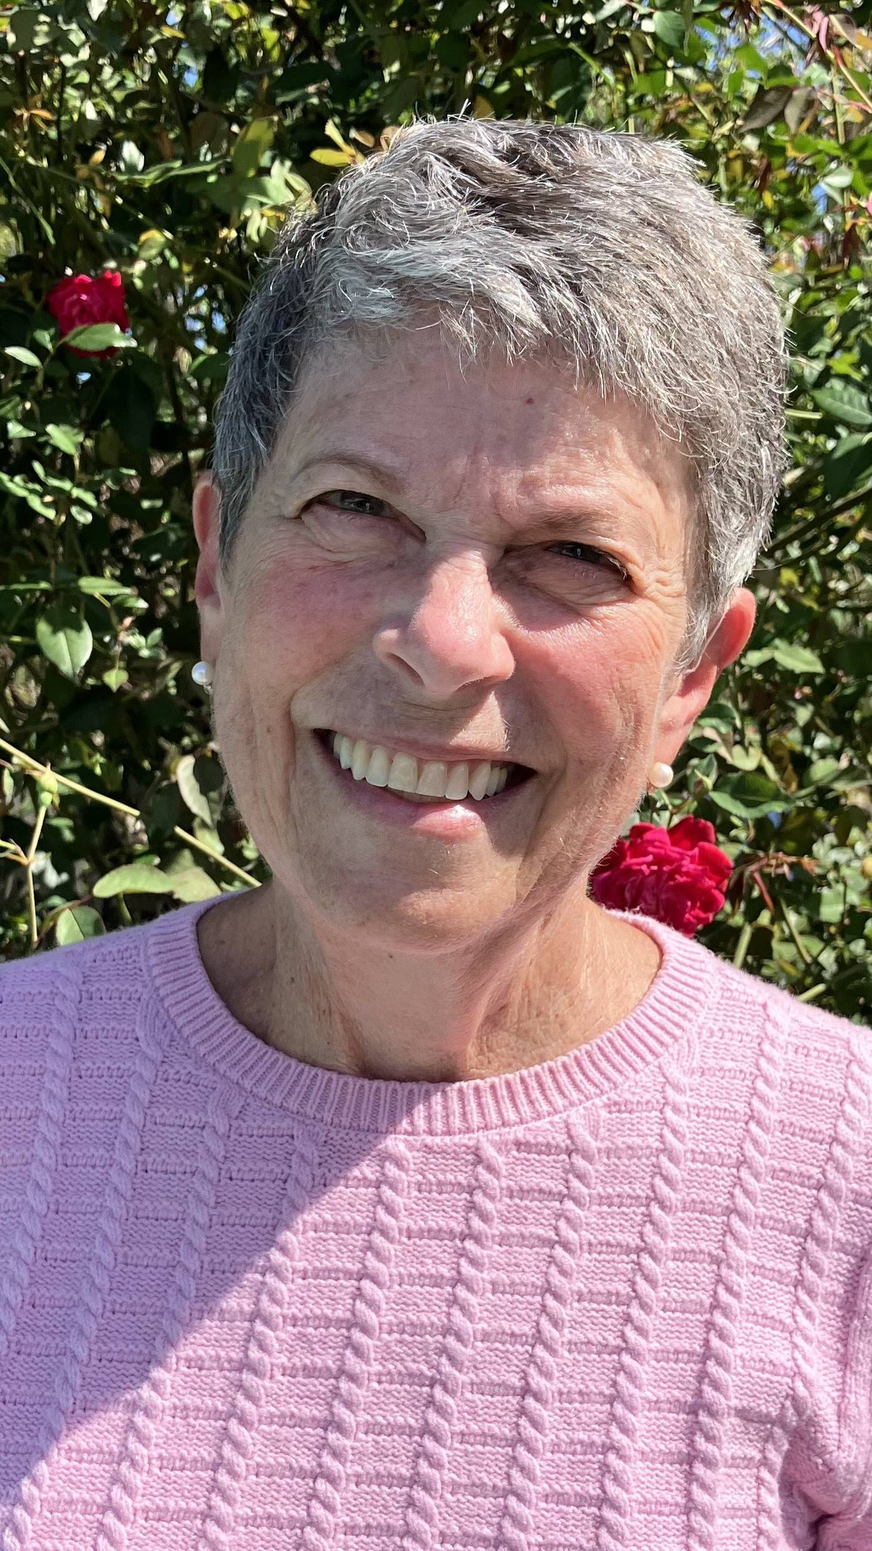
Edie WOLF
Pre-Op
“I have been a volunteer in the Pre-Op department at JMC for 15 years to support patients during challenging moments, be as helpful as I can to the nursing staff, and give back to my community. Volunteering allows me to make a positive impact, learn from dedicated medical professionals, and contribute to creating a compassionate, welcoming atmosphere for those in need. I value the friendships I have made with other volunteers, and walking so many steps in the larger new Surgical Institute keeps me fit!”

Slide 22
20 Years of Service

Slide 23
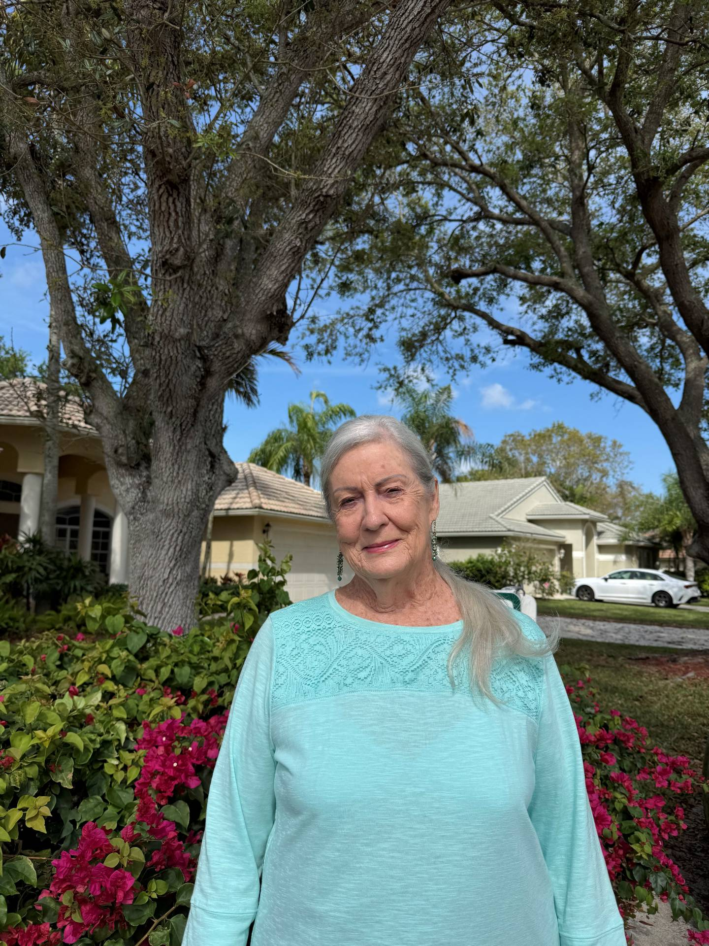
Mary Dore
Margaret W. Niedland Breast Center
"Volunteers took care of the community while I was working and raising my children. Now it’s my turn to do the same for others. I am so proud to be associated with Jupiter Medical Center. "

Slide 24
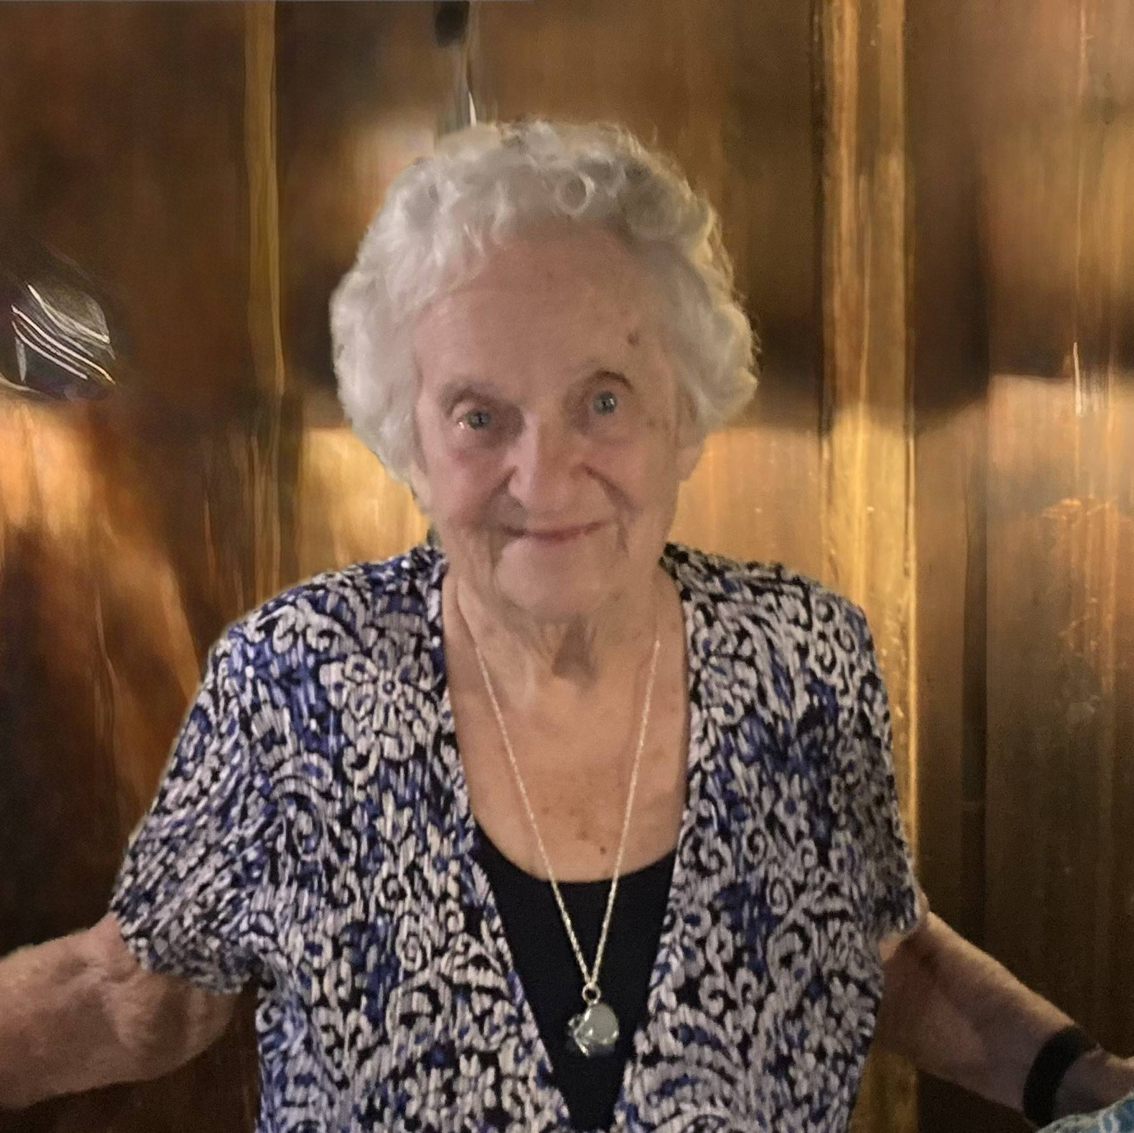
Flo Gosselin
Thrift Shop
“I have looked forward to volunteering at the Jupiter Medical Center Thrift Shop for the last 20+ years, and I have felt joy helping customers find special treasures with the goal of benefiting the Hospital. My favorite part of volunteering at the Thrift Shop is the time I get to spend with all the wonderful and dedicated people there whom I consider friends!”

Slide 25
25 Years of Service

Slide 26
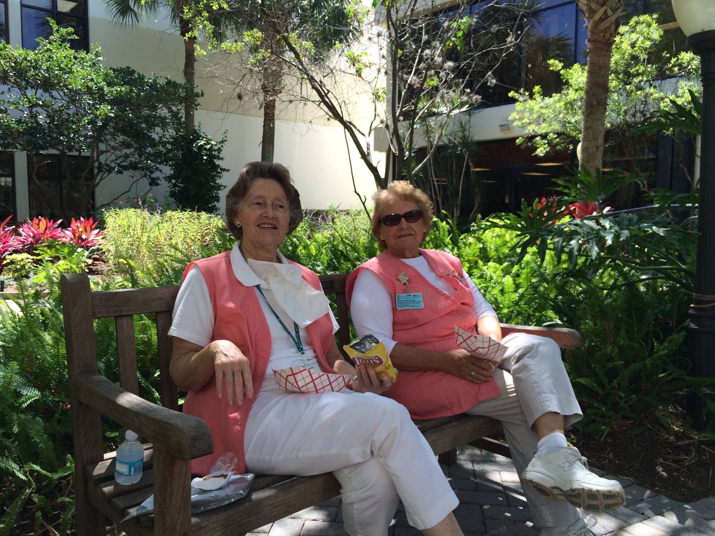
Barbara Shearon
Escort Desk
“I started volunteering after I retired because I wanted to serve others and be helpful to people.
My first job here at the hospital involved escorting patients to various departments, delivering specimens to the Lab, refilling water pitchers in patient rooms, and providing assistance to the team members as needed.
I continue to volunteer because I love working and assisting the patients, volunteers, and team members at JMC.”

Slide 27
30 Years of Service

Slide 28
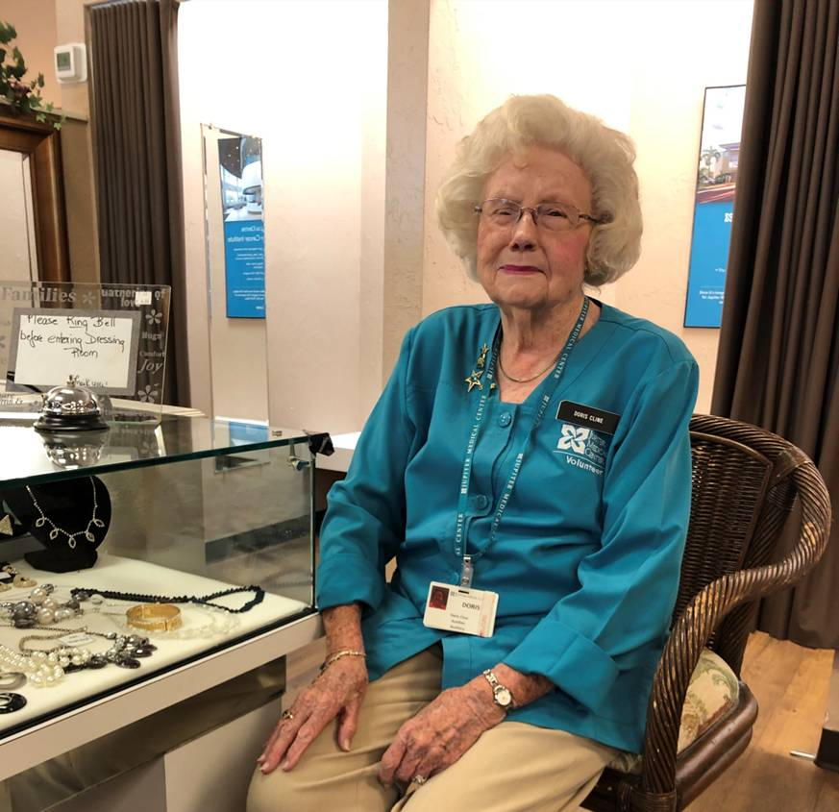
Doris Cline
Thrift Shop
“My sister, Nancy Hendricks suggested that I go over to the Hospital Auxiliary to volunteer and work at the Jupiter Medical Thrift Shop, so I did. I became a “pink lady”. It was a new experience, a place to see tourists and newcomers alike. The hospital has such a wonderful reputation, and it has been so nice to be part of. ”

Slide 29
45 Years of Service

Slide 30
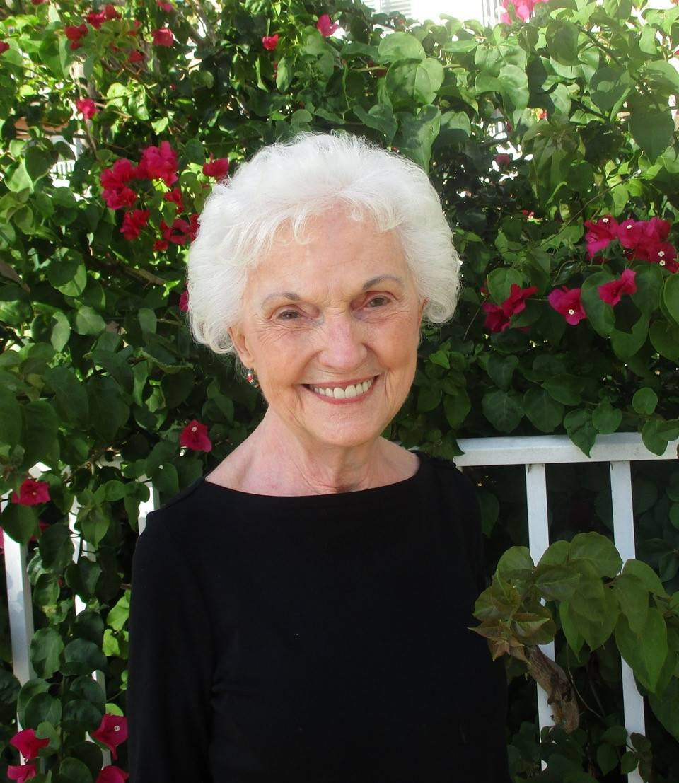
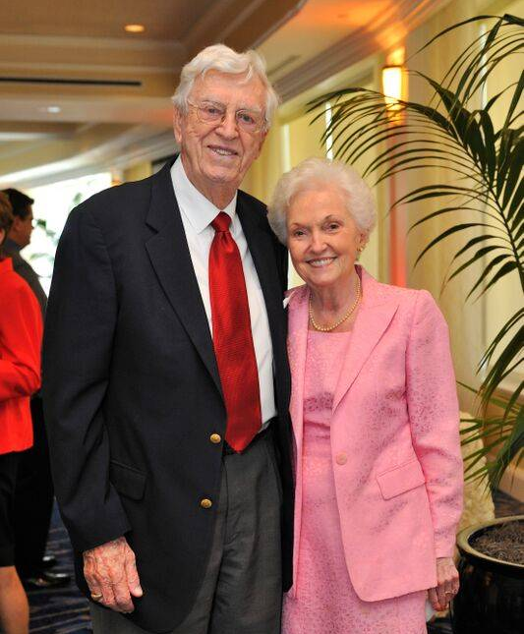
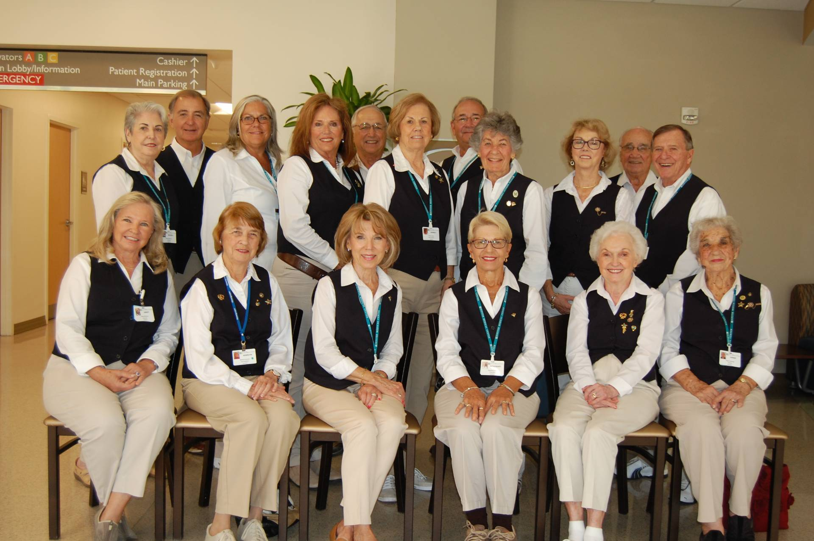
Mary Imle
Special Projects
Mary began volunteering soon after she settled in Jupiter. Her first assignment was in the Auxiliary’s Gift Shop, which had opened on Valentine’s Day 1979. After a year she created a new position, the Escort Desk. Mary was the first Dispatcher, a position she held for almost 30 years. In addition, she volunteered in Surgery Family Waiting and she was one of the original Greeters when the program began in 2009. For at least 30 of the 45 years, Mary worked 5 days a week.
During the COVID pandemic Mary found another way to volunteer: collecting donated items from residents in her senior living community for the JMC Thrift Shop.
Reflecting on her years of service, Mary says she is grateful for the privilege of being a part of the growth of the Medical Center.

Slide 31
Volunteer of the year

Slide 32
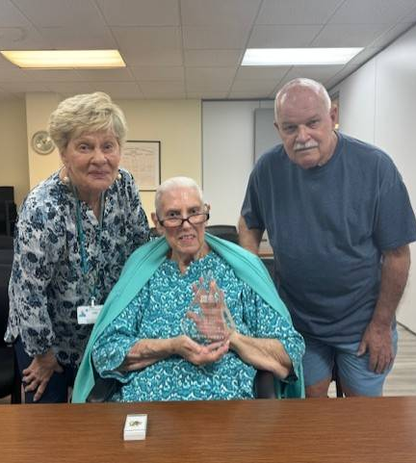
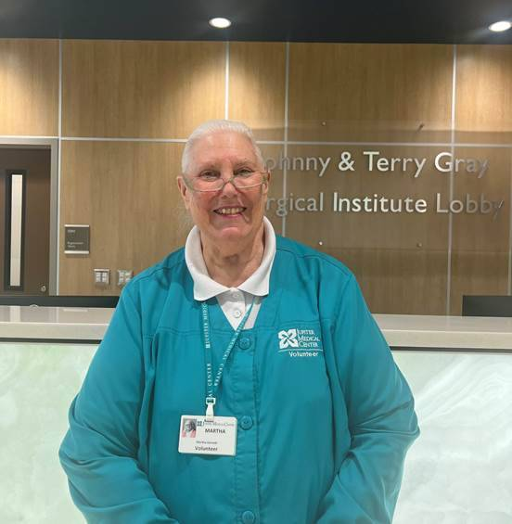
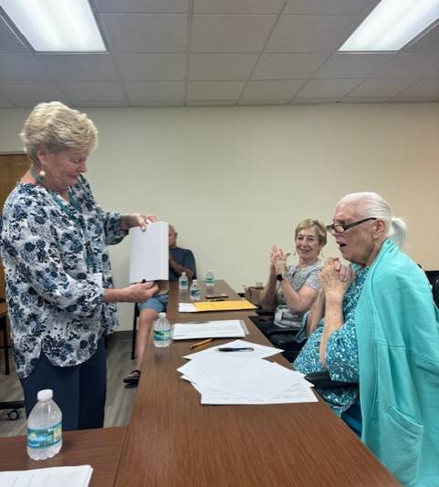
Martha Garnett
Surgical Lounge

